Slide 1
Chapter 1 Linux Terminal Commands
The first chapter is about general knowledge and commands on Kali Linux terminal that are commonly used on all Linux Systems.

Slide 2
Kali Linux Tutorial for beginners
This slide will contain some tutorials about Kali Linux installation and usage on VMWare machine and it should cover all the basics in terms of configuring its basics.
Notes:
Quick Introduction about the Slides:
These slides are intended to those who want to learn the basic functionality of Linux Systems in general, and Kali Linux specifically since all the commands and visual aids are done on Kali Linux. The features are straight forward and self-explanatory. I tried my best to make it as simple as possible, and keep in mind, I am not a professional writer where you expect all the details and explanations to be present. I am simply talking a little bit and diving straight to the point and how it can be done.
I Pray to God to be useful to those in need of learning Linux in general and remember me in your prayers.
Best regards.
Ahmed almashani

Slide 3
Downloading VMWare Workstation and then a virtual Machine Kali Linux from Kali.org
First, you need to download the VMWare workstation from its official website: https://www.vmware.com/info/workstation-player/evaluation
Choose the operating System you are currently using to download the right one, either Windows or Linux OS
After installing the VMWare workstation player, you can simply move to the next step, which is downloading the Kali Virtual Machine software from kali.org
Notes:
Installing VMWare is pretty much straight-forward. You will not need that much of configuration. Similar to installing any application on your windows.

Slide 4
Downloading the right virtual machine Kali from www.kali.org
Visit the website: https://www.kali.org/get-kali/#kali-virtual-machines
Open website, click on downloads, choose virtual machines, and choose VMWare option, which should be the first to your left.
Note:
you have two options to download, either directly, or through Torrent.
I personally, prefer the Torrent despite of its risk. It is faster and guarantees
delivery more quick
Notes:
After you go to kali.org, you can simply click downloads and then, choose virtual machines, and you will be given four choices to choose from.
You must choose the VMWare download, and personally, I will choose download through torrent if you have torrent client, but if not, just download
Directly through browser, but it might take a longer time and must have a very strong internet connection.

Slide 5
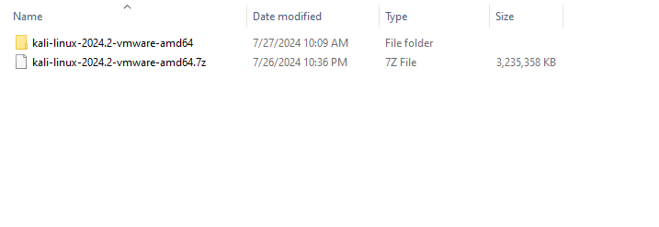
Extracting the Kali Linux File:
After completing the download, you should extract the files inside the gz file as it appears in the following picture:
Now, we can open the VMWare Player and start working as we will see in the next slides.
Notes:
You can use either WinRAR or 7z to extract the files and it is the best practice to extract to a folder that carries the same name as the filename.

Slide 6
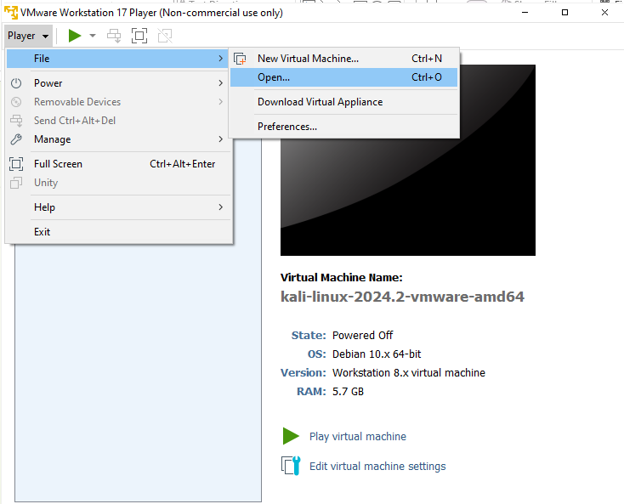
After opening VMWare
Go to player > File > Open
Then, browse to the folder where you extracted the gz file and browse inside, you will be given the file name to open.
After opening, you can edit Virtual machine settings and usually, you can keep all the settings the same except for the RAM, you might want to increase it to at least 2 GB, and the recommended RAM is 4 GB.
Notes:
After opening VMWare, you will be given choices at the top left of the corner, and you can simply click player to see the drop down.
Choose file and then, open…
After opening, head to the location of the extracted folder and open, and you will be given a IOS of Kali Linux.
After that, you should go to edit Virtual machine settings and modify the settings that you see appropriate and
Must consider the PC RAM and processors

Slide 7

After Turning on the Virtual Machine. Your System will Boot up
When you start booting up, you will be prompted to enter username and password:
Username: kali
Password: kali

Slide 8
You might want to update the repositories of Kali Linux after installation:
Updating repositories of kali Linux is one of the 10 top steps you must do after installing Kali Linux because it will keep you up to date. To do that, we can visit the URL: https://www.kali.org/docs/general-use/kali-linux-sources-list-repositories/
After visiting this website, we search for Switching Kali Main Branch:
After issuing this command, we can update and upgrade.

Slide 9

Be careful, if the new echo is causing issue, you need to know how to remove it:
You can simply issue:
This command will open the sources.list and then, you can remove the echo line added that causes the issue of updating and upgrading.
But it is recommended to add Switch Main Branch if you are using the real operating system, not the virtual one.

Slide 10
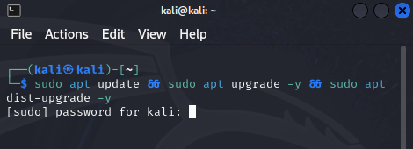
First Step to do after logging into Kali Linux System:
The first thing to do is update and upgrade as it appears in the picture to the right:
Updating is essential
Upgrading is also good and highly recommended to stay up-to-date.
dist-upgrade is the version of the kai Linux update.
After completing, you might be asked to issue the command:
Sudo apt autoremove
To get rid of the unnecessary packages on the system

Slide 11
Activating Proxy Chains in Kali Linux (Extremely important)
ProxyChains are a tool that protects your IP when browsing the Internet. The goal here is to keep your Private IP and Mac Address hidden using Chain of Free Proxy servers. In the following Slides, we will learn how to successfully activate the proxy chains on Kali Linux
Notes:
What is Proxy Chains?
Proxy Chains is the feature where it is a must thing to learn and configure if you are into hiding yourself on the internet.
It is an amazing feature and safe utility to protect you while browsing.
This part of the Tutorial talks briefly about the proxy chains and how they can be set on Kali Linux.
Keep in mind, proxy chains is only available on kali Linux, and there is a high probability it does not exist on other Linux
Operating System, but I am not 100% sure about that.
But to be able to use it for sure, you must have Kali Linux installed either on PC, Virtual Box, or VMWare.

Slide 12
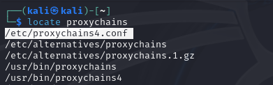
Steps to follow:
Issue the command: locate proxychains on the terminal
After issuing the command, we will be given a long list of options, we are only concerned with /etc/procychains4.conf as it is highlighted above.
Then, we will open the file using: sudo nano /etc/proxychains4.conf

Slide 13
Editing and Modifying proxychains4.conf file:
Before starting editing and modifying the proxychains4.config, you must be aware of the three cases or perhaps modes:
dynamic_chain: This is the process of select 1, 2, 3 for example. If 2 is down, it goes 1, 3
Strict_chain: this is the process of select 1, 2, 3 for example, if 2 is down, then your request fails because your proxy chain is restrict
Random_chain: this is the process of select 1, 2, 3 or 3, 1, 2 or 3, 2, 1 by random. If 2 is down, it can select 1, 3 or 3, 1
By default, it is set to strict_chain
You can only activate one of the options, you cannot have two working at the same time.
In addition to that, you must enable:
proxy-dns

Slide 14
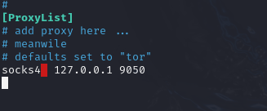
Where can we add our proxy servers in proxychains4.conf file:
At the bottom of the file, we can find something similar to the following:
It is where we will be adding the proxy servers we get from the internet.
Extremely powerful proxy servers are for money, but we can still manage to get some proxy servers for free.
In the next slide, we will see where we can get some free proxy Servers to use in our proxychains4.conf file

Slide 15
Getting Free Proxy Servers for our proxychains4.conf file:
A lot of free proxy servers are available online, but it is not that easy to locate a decent one, but among the free proxy servers that can be used is a website called spy.one and that is a famous Russian website and the link: https://spys.one/
We can start by using an IP collected from spys.one website: http 184.155.36.194 8080
Another example is http 172.158.58.140 8081

Slide 16
Installing Tor on Kali Linux
Tor is a tool that must be installed to complete the sequences of activating proxy chains. To install it, please issue the command: sudo apt install tor
After installing, we can check by issuing the command: service tor start
Checking it’s status: service tor status
Restarting the tor service: service tor start

Slide 17
Starting to work using the proxychains:
To open a browser, we can issue the command: proxychains firebox www.duckduckgo.com
It is wise to avoid opening google.com because it will detect the proxy and block the request. So, it is better to start opening a website that is not google or anything related to google such as youtube.com
As we open the browser, we will notice an activity taking place on the terminal.
Before we do that, we should change the mode from strict_chain to dynamic_chain inside the proxychains4.conf file

Slide 18
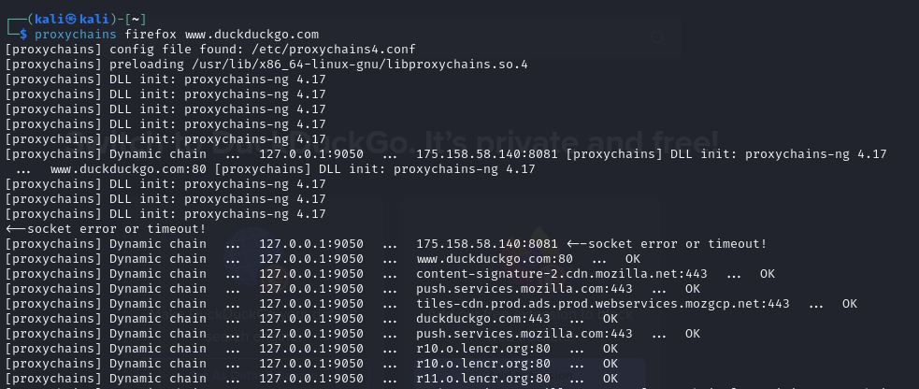
Proxychains firefox www.duckduckgo.com
The above picture illustrates how the code is functioning, but you should always avoid google.com because it can detect suspicious activity such as proxy servers in use. That is why we are using duckduckgo.com website to see if we can avoid it.
But since the dynamic is shifting between the localhost and the proxy server, it is only working on the localhost. Which means the proxy server is down or interrupted.
But what is important here is understanding the process, because it is not a must thing to work all the time, but it is important to be familiar with the steps of configuring proxychains

Slide 19
Basic Network Commands in Kali Linux
This section is devoted to talk about the basic commands you can use to deal with networking in Kali Linux and we will try to sum them up quickly.
Please view the slides to follow to learn more.
Notes:
Network Commands in Linux Generally:
Learning the basics of networking and how to configure and test your connectivity is crucial.
Even though some might think not learning more about networking is not important as long
As you have a connection, but this perception is completely wrong. Being familiar with network
Commands is extremely important and a major factor in mastering any operating system.
This portion of the Tutorial talks about the important of network commands in Kali Linux specifically.
I hope it is self-explanatory and straight-forward

Slide 20
To view the IP address in Kali Linux
ip add show: It shows you the ip address, it can also be written as ip address show
ifconfig: this is a net-tools command that displays the ip address
hostname -I: this is another command you can issue to see the ip address
hostname -i : this shows the localhost ip address, 127.0.1.1, also known as the loopback address… eth0 for Ethernet and lo for loopback
iwconfig: this is to show the ip address of the Wi-Fi if connected

Slide 21
More Network Commands that can be used and very important to be familiar with:
ip route show: this is a command responsible for displaying the routing table
Traceroute <IP Address>: This the command the traces the number of hops between you and the destination target… example: traceroute 140.0.1.1
ping: this command is used to check the connectivity of a host.
nslookup: this command is used to query DNS record. For example, nslookup ww.google.com… we will be getting the IP address of google back.
route -n: this command shows the ip routing table
tcpdump -i <Interface>: This command is responsible for analyzing and capturing data on a specific interface, but it requires root privilege. For example: sudo tcpdump -i eth0

Slide 22
More Network Commands that can be used and very important to be familiar with:
whois <domain>: this is the command that returns back information about the registration information of the domain. For example: whois google
arp -a: display or manipulate the arp table
sudo systemctl status networking: this command shows the status of Kali networking. It is either active or disabled…
sudo systemctl start networking: this command starts the networking on kali Linux.
sudo systemctl stop networking: this command stops the networking on kali Linux
sudo systemctl restart networking: this command restarts the networking on kali Linux
sudo systemctl enable networking: this command is to enable network service on boot.
sudo systemctl disable networking: this command is to disable network service on boot.

Slide 23
More Network Commands that can be used and very important to be familiar with:
sudo systemctl status NetworkManager: this command shows the status of Kali NetworkManager. It is either active or disabled…
sudo systemctl start NetworkManager: this command starts the NetworkManager on kali Linux.
sudo systemctl stop NetworkManager: this command stops the NetworkManager on kali Linux
sudo systemctl restart NetworkManager: this command restarts the NetworkManager on kali Linux
sudo systemctl enable NetworkManager: this command is to enable NetworkManager service on boot.
sudo systemctl disable NetworkManager: this command is to disable NetworkManager service on boot.

Slide 24
NetworkManager in Kali Linux Command line:
In the following, we will be discussing some of the basic commands you can explore using the NetworkManager in kali Linux. It is important to be familiar with the syntax and pay attention to the tab because it helps you complete the syntax or perhaps choose from options given to you below

Slide 25

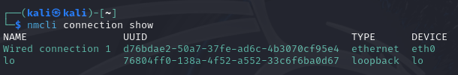
Introducing some CLI commands using NetworkManager in Kali Linux:
nmcli general status: this command line shows the network status
nmcli connection show: this command line shows the available connections

Slide 26
Introducing some CLI commands using NetworkManager in Kali Linux:
nmcli connection down “connection-name”: this command disconnects from a specific connection. For example:
\
nmcli connection up “connection-name”: this command connects a specific connection name. For example:

Slide 27


Introducing some CLI commands using NetworkManager in Kali Linux:
nmcli network off: this command turns off the network
nmcli network on: this command turns on the network

Slide 28
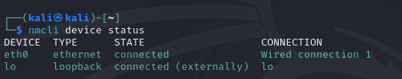
Introducing some CLI commands using NetworkManager in Kali Linux:
nmcli device status: this is the command responsible for showing the status of the devices connected.

Slide 29


Introducing some CLI commands using NetworkManager in Kali Linux:
nmcli device wifi list: this is a command to see the available networks.
nmcli device wifi connect <SSID> password <password>: This is the command we issue if we want to establish a connection with a wifi network using the nmcli. Note: device not found means the current adapter I am using to connect to the Wi-Fi is not working, and must be active for this command to display a different message

Slide 30
Some General Configuration and Commands to use in Kali Linux:
In this portion, we will be diving into installing, uninstall, listing packages in Kali Linux. We will also talk briefly about the most important apps you might want to have installed on Kali Linux as well. With no further ado, we will start now …. ;)
Notes:
Initial Commands you must know in kali Linux:
This part talks about he basic commands in terms of updating, upgrading, installing packages and more.
This part is a must thing to know for sure, you don’t have a choice because it is the first thing you must
Do after installing Kali Linux. You need to be familiar with the major commands and know how the syntax
Work.
Again, this is a very important part to know and master.

Slide 31
Methods of Installing Packages in Kali Linux Operating System:
In this section, we will be talking about installing packages and uninstalling of packages using sudo apt
We will be talking about sudo dpkg –install <package-name> that allows us install debian packages
We will be talking about sudo dpkg –remove <package-name> that allows us to uninstall debian packages.
We will be talking about sudo dpkg –pure <package-name> that allows the entire removal of the packages and all its related files from the system.

Slide 32
Sudo apt update && sudo apt upgrade -y
The above command is basically the first command we should issue right after installing Kali Linux. It simply visits the kali download package through using a path /etc/apt/sources.List file where inside there is a path specified wherefrom the kali Linux can update its packages and system
Another command we should consider is sudo apt dist-upgrade. This command checking the distribution currently installed and searches for updates regarding the distribution, and if it locates any, it starts upgrading the distribution.
sudo apt is mostly used for updates, upgrades, dist-upgrade, installing packages from sources.List file using Kali/Downloads online. There are other apps available to install deb extension packages such as dpkg.
Sudo dpkg – option is mostly used for installing, removing, and purging packages from the operating system.

Slide 33
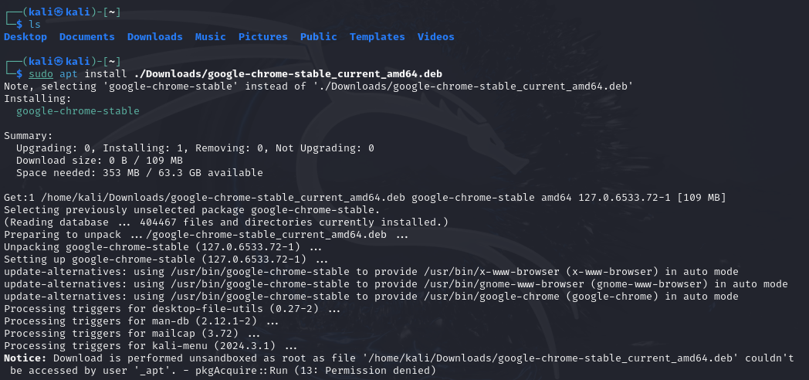
Using sudo apt install to install deb packages on Kali Linux:
We can directly install packages using sudo apt install <path/package-name.deb>

Slide 34
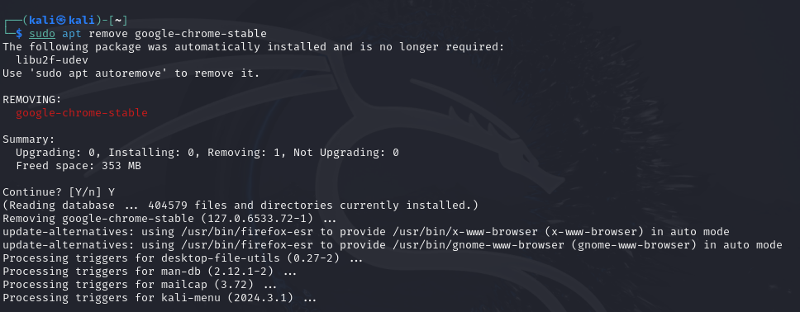
Using sudo apt remove <installed-package-name> from Kali Linux:
Removing google-chrome-stable sudo apt remove google-chrome-stable

Slide 35
Some important tips to keep in mind when dealing with sudo apt and sudo dpkg
If you want to install something from the Kali Linux online sources, you should always use: sudo apt install <package-name>
If you want to install a package downloaded from internet with *.deb extension, you should always use dpkg as it appears: sudo dpkg –install <directory/package-name.deb>

Slide 36
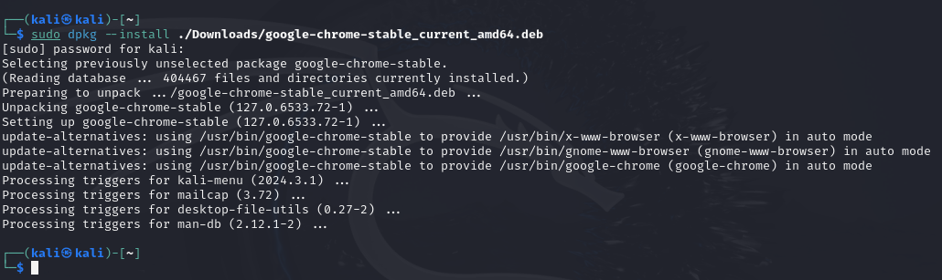
Using sudo dpkg --install to install a debian package downloaded:
To do the same with dpkg, we can issue the command: sudo dpkg --install ./Downloads/google-chrome-stable_current_amd64.deb

Slide 37
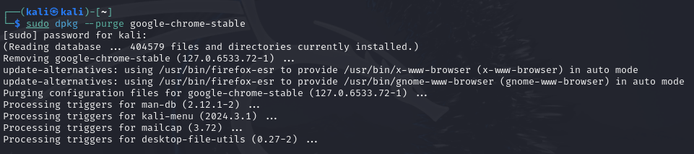
Using sudo dpkg --purge to remove google-chrome-stable with all its related files:
--purge is more suitable for use than remove because it removes anything related to the package we are about to remove, the syntax: sudo dpkg --purge google-chrome-stable

Slide 38
How to list packages installed using sudo dpkg --list or sudo dpkg -l
To view list of all packages installed, we can issue the command: sudo dpkg --list this command will display everything and the list will be extremely long, if you want to exit it, just press q
To view a specific or search for a specific package, we can issue the command: sudo dpkg --list | grep <name of package or related to it>

Slide 39
Some Important packages to have installed on your Kali Linux
This portion will be covering some of the most important apps you should have on your kali Linux. Some usually come already installed and if they are not, you should install them
Notes:
Some Packages to install after installing Kali Linux:
This part talks about some packages to consider downloading and installing right after installing the Kali Operating System.
They are not required, but more like a best practice to have these packages and apps run on kali Linux.

Slide 40
Packages to install if they are not already kali Linux:
nano: nano is a text editor that allows you to open and edit files in the terminal window, and it is quick and fast and most of the time used to modify files on hurry such as /etc/apt/sources.List file where you can simply add a new repository to your list. It is also effective in opening any other formatted file and able to edit it as well.
vscode: Visual Studio code is one of the most widely used text-editors open-source designed by Microsoft and it is essential in coding and writing programs. It is also light-weighted and provides a lot of snippets that can help in accelerating work timeframe and syntax auto-completion.
tilix: tilix is a terminal that has the ability of opening several terminal windows on the same original terminal giving you the ability to move quickly and easily between terminal windows. Even though it might give some issues with new versions of Kali Linux, but I think it is still working.

Slide 41
Most Commands a Linux User must be familiar with
In the following portion of the presentation, we will be enlisting most of the must-know commands to deal with Kali Linux or perhaps in Linux distribution out there, there might be some differences in usage, but the majority are the same.

Slide 42



List of Must-Know commands in Linux Systems:
pwd: this is the command that shows you the current location
whoami: this is the command that shows you the current user logged in
ls: this is the command responsible for displaying the content of your current directory.

Slide 43
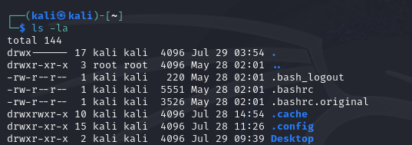
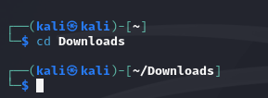
List of Must-Know commands in Linux Systems:
ls -la: this is the command responsible for displaying the content of the current directory plus the hidden files and folders.
cd: this is the command responsible for browsing the paths. For example, to go to Downloads folder, we can issue: cd Downloads

Slide 44

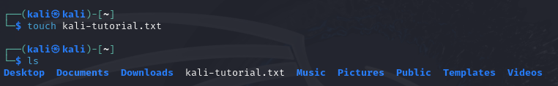
List of Must-Know commands in Linux Systems:
cd ..: this is the command if we want to move backward. Using the previous example, if we want to go back to Kali, we can issue: cd ..
Note: to move two folders up, we can simply add / and then, .. As it appears in the following code: cd ../..
touch: this is the command we can issue if we want to create a file of any extension without content, empty file:

Slide 45
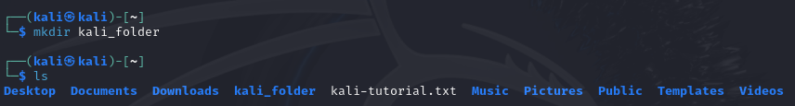
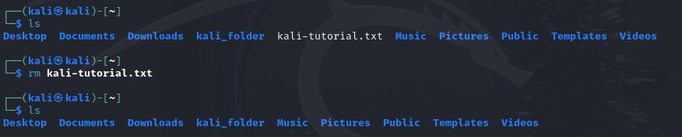
List of Must-Know commands in Linux Systems:
mkdir: this command can be used if you want to create folders: mkdir kali_folder
rm: this is the command line that can delete files. rm kali-tutorial.txt

Slide 46
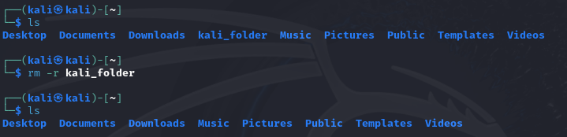
List of Must-Know commands in Linux Systems:
rm -r: this is the command line responsible for deleting folders and their subfolders and files. It should be always used with caution: rm -r kali_folder
Note: if we try to delete a folder using rm alone, it will return error saying folder not empty. Therefore, remember rm is for files and rm -r for folders regardless if they are empty or contain subfolders and files.

Slide 47
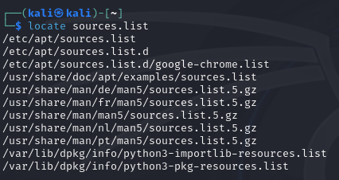
List of Must-Know commands in Linux Systems:
locate: this command can search for whatever you specify and give you back the paths and locations of it. For example, suppose we want to look for sources.List file, how can we find its path: locate sources.List
Notes:
Usually, the first option given here is what you are looking for.

Slide 48
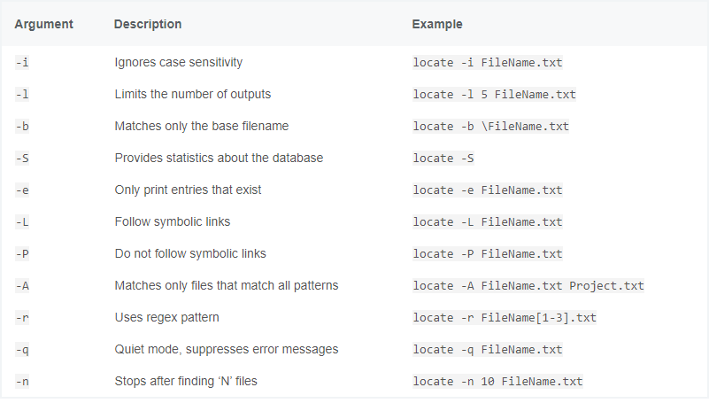
List of Must-Know commands in Linux Systems:
locate command options to use:

Slide 49
List of Must-Know commands in Linux Systems:
find: the command find is for finding files, directories anywhere in the file system of the system. It can be a little bit dangerous if used to execute some commands at the same time, because writing the wrong command can cause the system to crash if you are not carful. But we will be exploring some of its amazing features. Even though it functions the same way like locate, but it is designed for searching through the system files rather than system database.
Note: always make sure the syntax is written correctly before execution. In the next slide, we will be exploring different features of find and for the purpose of staying limited, we will be creating and running terminal from Desktop and limit our find search to it

Slide 50
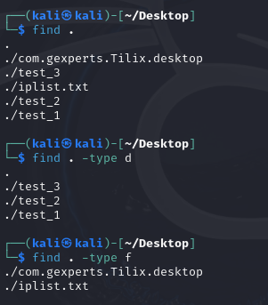
Find command different syntax
Below is a list of different usage of find… Since we are using the find on the desktop, we can limit the results to the content of desktop. Find . => gives back all the folders and files on desktop
Find . –type d => gives back only the directories and folders on desktop
Find . –type f => gives back only the files on the desktop

Slide 51
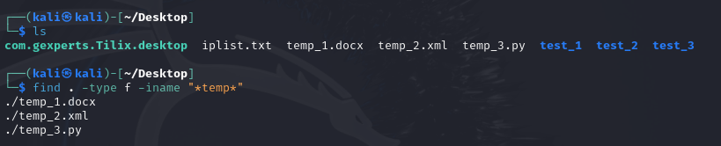
Find command different syntax
Find . -type f -name “*temp*” ➔ this command will search for anything that contains the letters and that is why we surrounded it with *
Same command can be issued with:
Find . -type f -iname “*temp*” ➔ the difference here is that iname is not case-sensitive, which means whether letters are up or lower, if it matches, it returns a result back
Notes:
Find is one of the most complicated Linux commands and it should be used with caution. A wrong command with execution can result in a severe and fatal error in the entire Kali Linux system. So please be careful when dealing with this command. If you are searching for something, It is more wise to use locate instead.

Slide 52
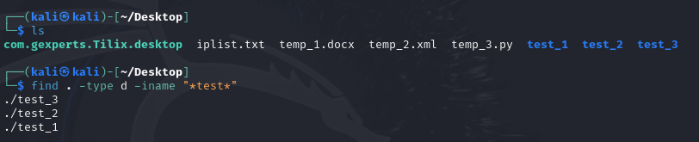
Find command different syntax
Same command lines can be used to search for folders. Suppose we want to display all the folders that contain the word test: find . -type d -iname “*test*”
Another option we can use here is -empty and it can be used on both files and folders, it simply returns back the empty files and folders as we will see in the next slide.

Slide 53
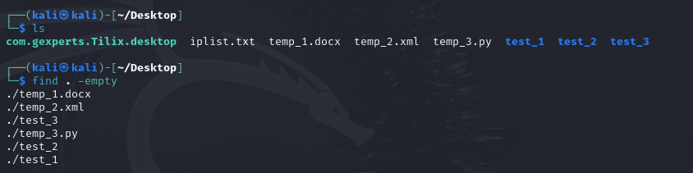
Find command different syntax
To find empty files and folders on the desktop, we can simply issue the following command line: find . -empty
We can also use other options along with empty, find can accept different options at the same time.

Slide 54
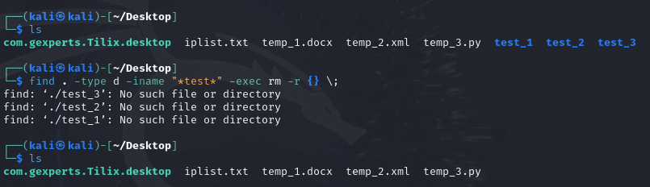
Find command different syntax
To execute a command line for the results we get back from find, we can add another option called -exec as it appears below. We will try to delete all folders that has test: find . -type d -iname “*test*” -exec rm {} \;
Notes:
Explanation of the message: no such file or directory comes after deleting the folder.
Even though it seems the code is not working, but it actually works, and that is why find command should always be used with caution and if you can use locate instead, you should go for it with no hesitation.

Slide 55
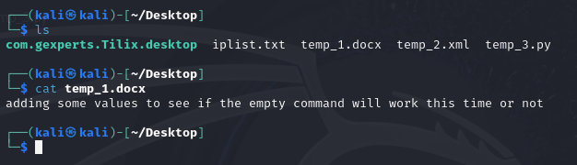
List of Must-Know commands in Linux Systems:
cat: cat is a command that allows you to read the content of a file on the terminal… for example, suppose we have temp_1.docx and want to read its content, we can simply issue: cat temp_1.docx

Slide 56
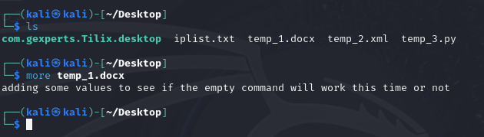
List of Must-Know commands in Linux Systems:
more: more is another command similar to cat in terms of displaying content on the terminal, but it is more comprehensive. Meaning, it might display all the content on the terminal if possible. more temp_1.docx
Notes:
cat and more commands are almost the same and sometimes, you cannot tell the difference between the two.
But it is good to know you have an alternative option in case if one slips away from your memory ;)

Slide 57
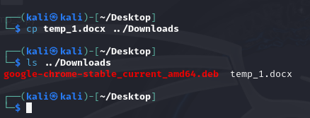
List of Must-Know commands in Linux Systems:
cp: this command is used to copy a file to a different location cp temp_1.docx ../Downloads/copied_temp_1.docx
cp -r: this command is used to copy a folder and its subfolders and files to a different location
Notes:
cp is a command that can be used to copy files from one location to another.
For example:
cp file_name.txt <path>

Slide 58
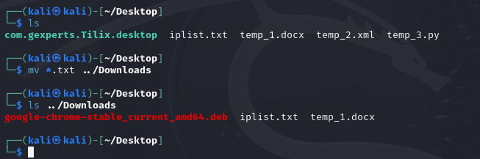
List of Must-Know commands in Linux Systems:
mv: mv is a command line that can do the copying and also, rename of a file or folder. For example: mv *.txt ../Downloads/
Note: if you are not specifying a name, it will copy the file as it is, but if you are specifying a name, it will rename the file to the new name

Slide 59
Some links to learn more about Linux commands and how they can be applied:
It is extremely important to understand how a command works than memorize its syntax. Therefore, Here are some links to visit in case if you want to learn more about these commands and add more knowledge by learning more as it is like an ocean of commands out there to learn:
https://www.geeksforgeeks.org/linux-commands-cheat-sheet/
https://www.linuxtrainingacademy.com/linux-commands-cheat-sheet/

Slide 60
User Permissions in Kali Linux
This part talks, briefly, about the permissions in Linux in general and Kali Linux in specific since the operating system in use is Kali Linux.
Notes:
Permissions In Linux:
This part talks about permissions and how to set them on files and directories in Kali Linux.
The commands are the same on all Linux Distributions.
Learning about permissions is important, I wouldn’t say it is a must thing to have right away
But be familiar with their syntax and procedures are important in the long run.
So I would highly recommend to be familiar with this section as well.

Slide 61
Some tips to know about permissions
To view the permissions on a specific folder or file, we can issue: ls -la
To the right, you will see three levels: example: rwx-rw-r
Permissions are classified to three levels: 1. user 2. group 3. others
Note:
rwx stands for read, write, and execute
Each level has three options: rwx-rwx-rwx as you will see in the following slide

Slide 62
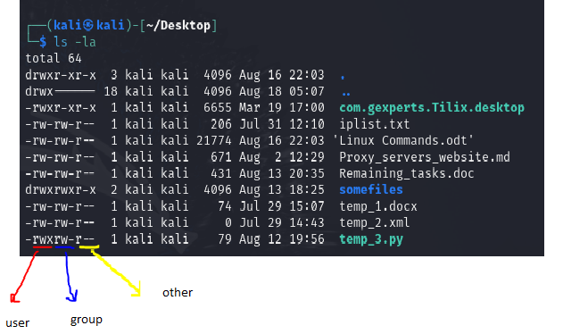
Listing the files and viewing their permissions

Slide 63
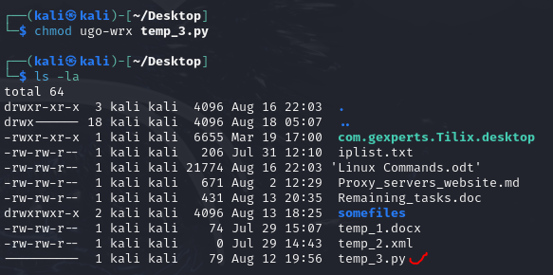
Trying to change permissions for temp_3.py file
Suppose we want to change the file permission on temp_3.py to accept only execution, and revoke read and write permissions:
We have revoked all the permissions, if we try to open the temp_3.py using nano app, it will refuse to open because of the permissions as we will see

Slide 64

Checking the temp_3.py file after changing its permissions

Slide 65
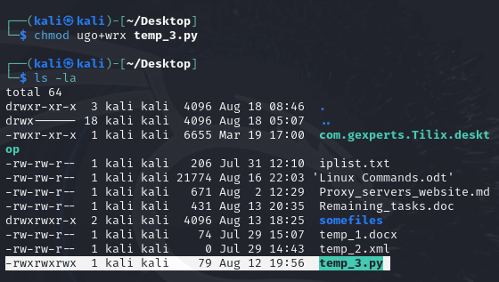
Granting permissions back to temp_3.py file

Slide 66
Some more Syntax in terms of changing permissions separately:
For user example:
For group example:
chmod u+rwx <filename> granting read, write, execute
chmod u-rwx <filename> revoke read, write, execute
chmod u+w <filename> granting write only
chmod u-r <filename> revoke read only
chmod u-rw <filename> revoke read and write permissions
chmod g+rwx <filename> granting read, write, execute
chmod g-rwx <filename> revoke read, write, execute
chmod g+w <filename> grant write only
chmod g-r <filename> revoke read only
chmod g-rw <filename> revoke read and write permissions

Slide 67
Some more Syntax in terms of changing permissions separately:
For Group Example:
chmod o+rwx <filename> granting read, write, execute
chmod o-rwx <filename> revoke read, write, execute
chmod o+w <filename> granting write only
chmod o-r <filename> revoke read only
chmod o-rw <filename> revoke read and write permissions

Slide 68
Summary points of using permissions
chmod is the command used to change permissions for a file or directory.
rwx stands for read, write, execute
There are three levels for permissions: user, group, and others
Permissions are important to set permission levels. For example, if you want a file to be only for execution, you can revoke read and write, and only permit execute
User-group-other: rwx-rwx-rwx

Slide 69
Checking System Storage
This portion of the slides is a quick view of the two most used commands used to check the storage used and available on the Linux System.

Slide 70
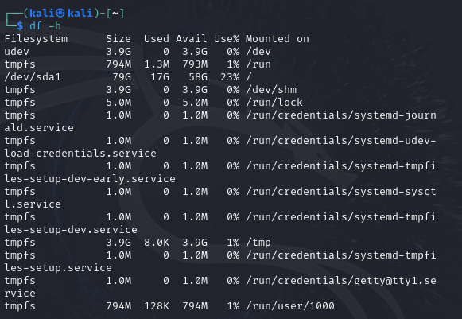
df command to check Free storage and availability of disk on the Linux (disk free)
df is a Linux Utility that allows you to check the Linux Partitions and disk space:

Slide 71
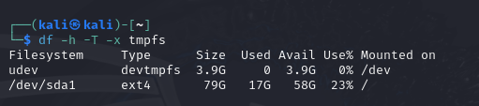
df command to check Free storage and availability of disk on the Linux (disk free)
df has options that can be used such as -h to display numbers in a human readable way, -T to display type, and -x to exclude certain files if desired
You can also combine all options together instead of typing them separately, you can do: -hTx
We excluded files with tempfs names. If you go to previous slide, you will see the display if -x option is not used.

Slide 72

du command to check a specific path size along with its content (disk usage)
du is a Linux utility that allows you to check the size of a specific folder, file, and also, allows you to specify the depth of checking size as we will see in our example below:
In the next slide, we will be using the ---max-length option to specify how deep the du command should reach to check.

Slide 73
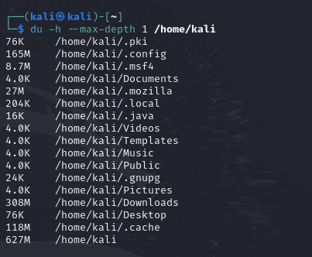
du command to check a specific path size along with its content (disk usage)

Slide 74
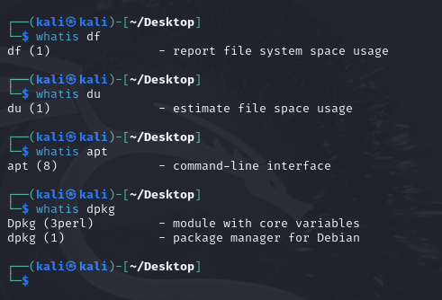
whatis command line usage
Before forgetting the importance of this amazing command, we should highlight how it can be used. whatis command is used to define the command line and what it is used for. In case if you want to know what a command is use for, you can simply type whatis followed by the command and you will get a brief definition of its execution nature. For example:

Slide 75
Compressing and Decompressing Files and Folders
This is the part where we will be talking about some apps that can be used to compress and decompress files and folders in Linux.
Notes:
Compressing and Decompressing in Kali Linux:
Compressing files is important to know. Even though there are features and apps already out there where you can simply install free software and simply deal with GUI, graphical user interface, apps. But learning how such work can be done on a terminal is important. Remember, you are using Kali Linux mostly because of its terminal and increasing the amount of commands that can be used and get tasks done there is important as well.
Therefore, learning this portion is not bad.

Slide 76
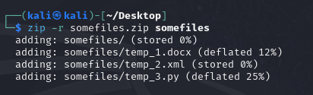
Compress and Decompressing using Zip
Zip is a utility that can be used to compress and decompress files.
Zip utility can also encrypt the compressed files and require a password to decompress them.
Compressing the somefiles folder:
-r is the option usually used with compressing folders with zip utility. It is a required option if we are compressing folders and their subfolders.

Slide 77
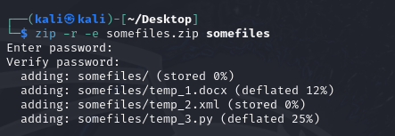
Compressing and decompressing using Zip:
Compressing somefiles folder with encryption:
If you notice, when you use the option -e, you are prompting for encryption. The zip utility will give you password to enter and confirm.

Slide 78
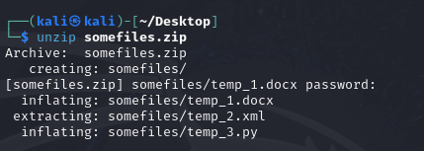
Compressing and decompressing using Zip
To decompress, we will be using unzip.
Example of unzipping somefiles.zip we created previously:
If the zip file is encrypted, you will be given the option of entering the password to decompress the file. If there is no password set on the zip file, it will directly decompress

Slide 79
Compressing and decompressing using Tar
Tar is a built-in utility inside Linux where we can compress files and it functions the same way as zip, but it is a little bit more complicated in terms of creation since encryption requires additional steps. Some of its built-in functionalities are no longer supported, but can be used with other utilities such as ccrypt utility to create encryption. Ccrypt is not usually a built-in utility. You have to install it using sudo apt install ccrypt
we can use gpg utility to encrypt the tar file, and it is already a built-in utility.
We will be using in the following slide an example on how to create a basic tar file and then, use gpg utility to encrypt the file.
Notes:
Very Important note about Tar Utility:
Tar does not have an encryption method to set a password or passphrase on the compressed file. It used to have one before, but the feature has been deprecated and now, we must use other utilities such as gpg or ccrypt to make the encryption

Slide 80
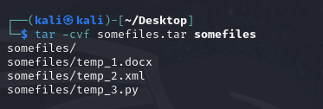
Compressing and decompressing using Tar
Creating a basic tar file on somefiles folder:
This is the basic way of creating a tar compressed file. But bear in mind this style only creates a tar file without compressing, to compress it we can add another feature as we will see in the next slide.

Slide 81
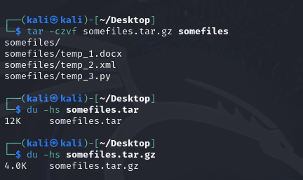
Compressing and decompressing using Tar
We should use the –czvf instead of –cvf because z stands for gzip
As you can see, we have created the file and the last two parts are a comparison between somefiles.tar we created previously with somefiles.tar.gz we just made to show the size of each compressed file. It is clear now that tar does not compress files unless gzip is incorporated with it
Notes:
Difference between -cvf and -czvf:
cvf stands for –Create –Verbose –Filename
czvf stands fr –Create –gzip – verbose – filename
CVF compresses a tar file without changing its size.
CZVF compresses a tar file with GZIP and changes its size.

Slide 82
End of Chapter 1

